Slide 1
P-I-T 2009
THE PORTRAIT OF HOMELESSNESS IN FAYETTE COUNTY
Notes:
Point and Time 2007 youtube.com

Slide 2
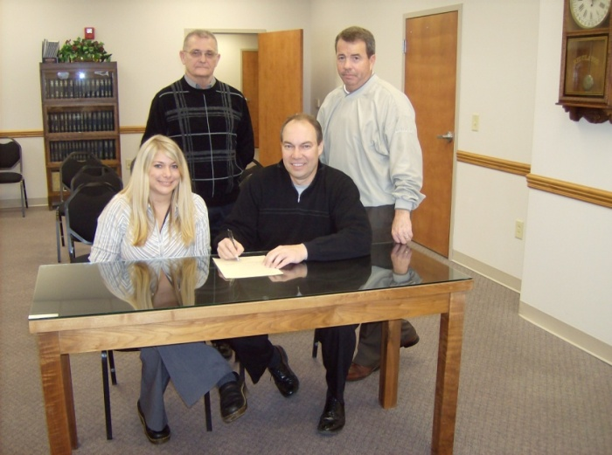
Pre-count
Point-in-Time Committee
Community Outreach
Public Speaking Engagements
2 Newspaper Articles
1 Radio Spot
Flyers
Contacting Agencies/Churches
Local Governmental Support – County Resolution & City Manager Statement of Support
41 Volunteers

Slide 3
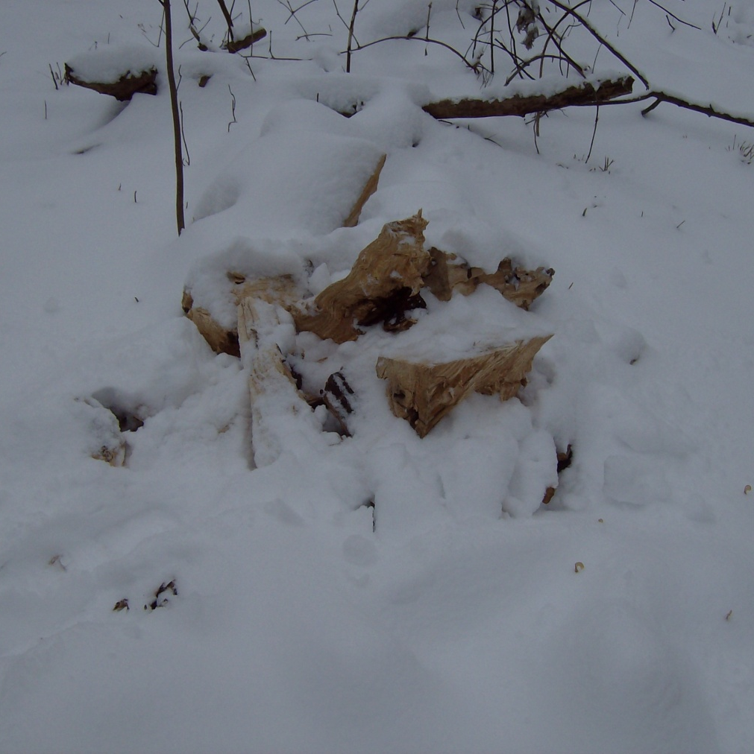
It was a blistering cold day in January
-Service Based Count
-Street Count
-Sheltered Count
-Soup Kitchen
Firewood Covered by the Snow Storm
Notes:
7 families total dropped into the center
Wrap Around Services
Tell the stories of those we helped that day

Slide 4
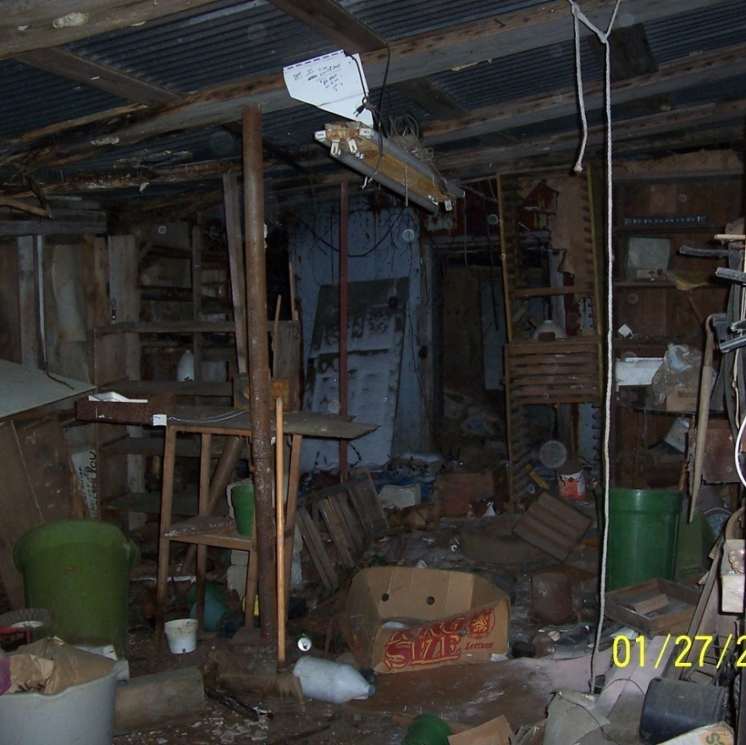
The troops when out at midnight & continued their track until 11:00 that night
UNDER A LEVEL 2
Notes:
Insert Story About the paper

Slide 5
Point in time at a glance
The Numbers At a Glance
95% of sheltered data reported from HMIS
96 Precariously Housed
81 Persons Total
59 Sheltered
16 Unsheltered

Slide 6
POINT IN TIME 2009
Homeless by the Percentages

Slide 7
Point in time 2009

Slide 8
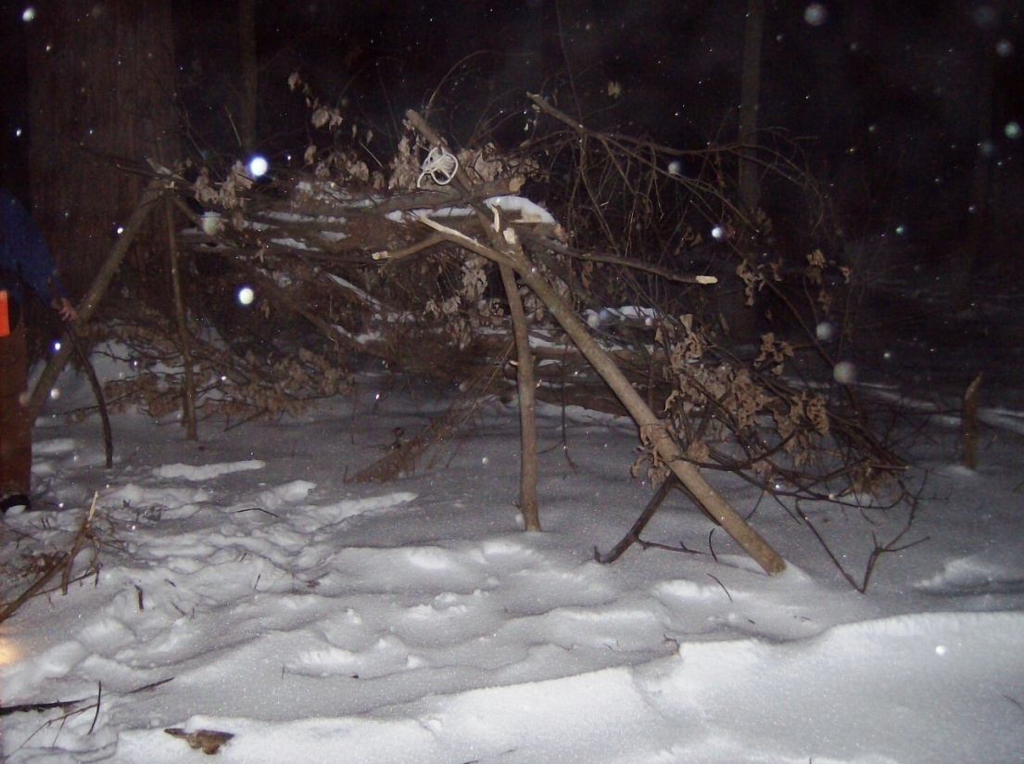
Unsheltered count
16 Total
13 single Male
3 single Female
6 Chronically Homeless
10 disabled

Slide 9
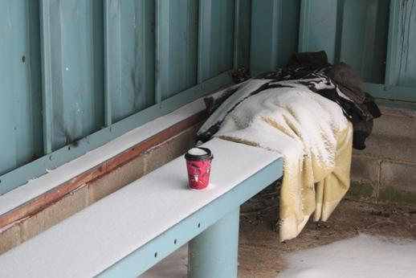
Unsheltered count
1 Severely Mentally Ill
1 Drug Abuse
2 Alcohol Abuse
5 Physical Disabilities
1 Victim of DV

Slide 10

SUMMARY OF WHO IS HOMELESS

Slide 11
Next steps
Expand Point in Time Count to include a Summer Count
Create an awareness event atmosphere with homeless speakers and events during the evening
Invite local television to shadow
Use this data to justify and expand existing programs
Pat ourselves on the back for what we are doing well

