Slide 1
Point in Time 2012
Everyone Counts!

Slide 2
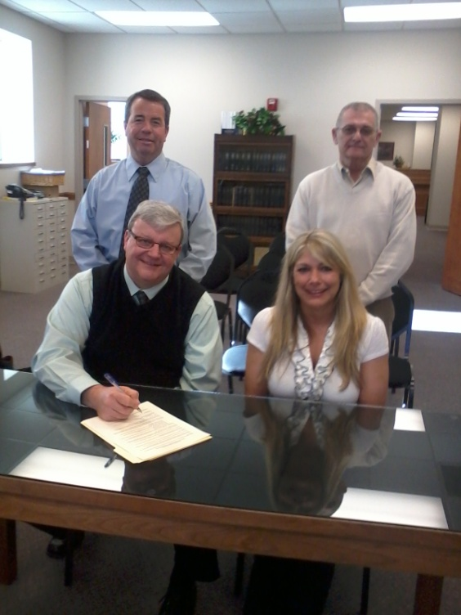
Before the Count
Community Outreach
Public Speaking Engagements
2 Newspaper Articles
Contacting Agencies/Churches
Local Governmental Support – County Resolution

Slide 3
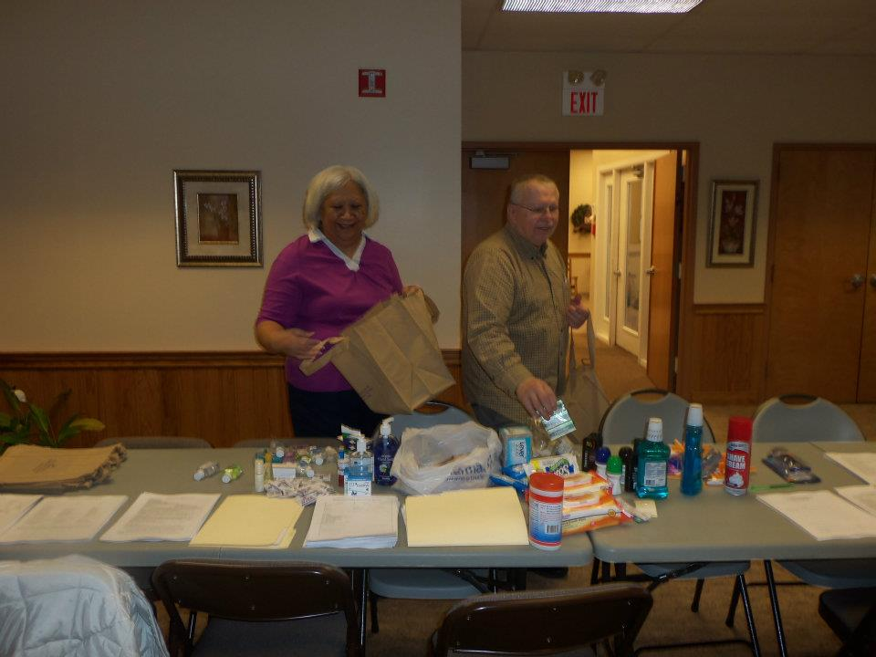
Methods
Service-Based
Street
Sheltered
Homeless Project Connect
School District
Homeless Project Connect
Notes:
Service-Based – 3
Street – 11
Sheltered – 51 3(MSH)
SD- 41 HH – 146 individuals
Project Connect – 7 homeless, 9 at risk 4 couch =20 adults; 7 children (27)

Slide 4
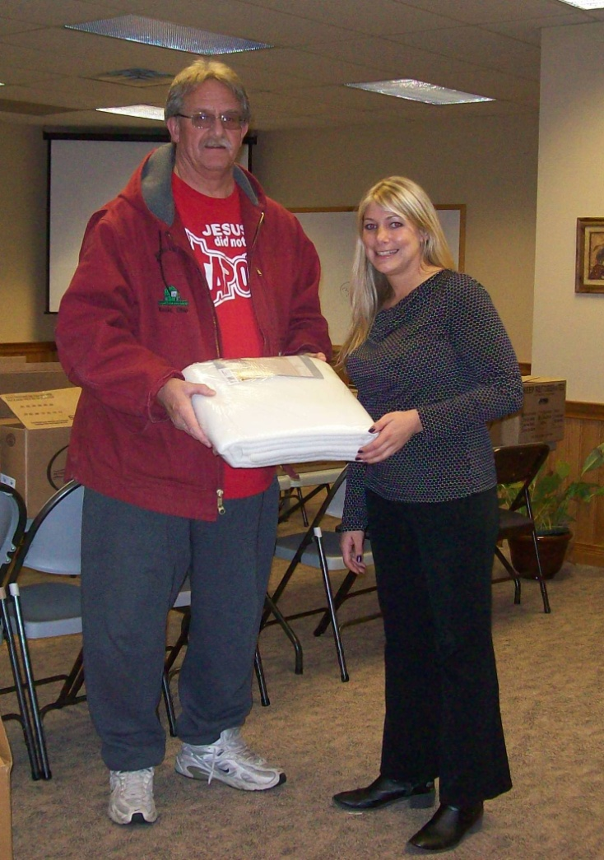
Volunteers
42 Individuals Volunteered for the Project Homeless Connect & Street Count

Slide 5
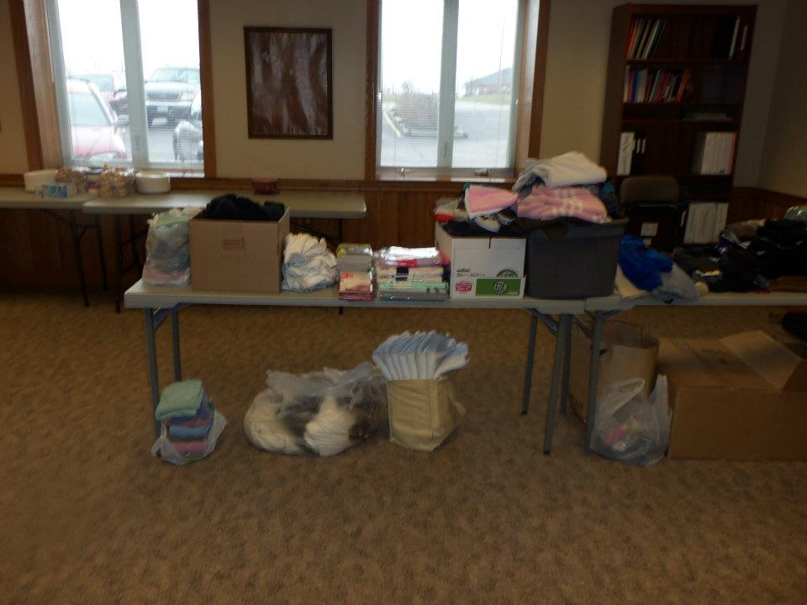
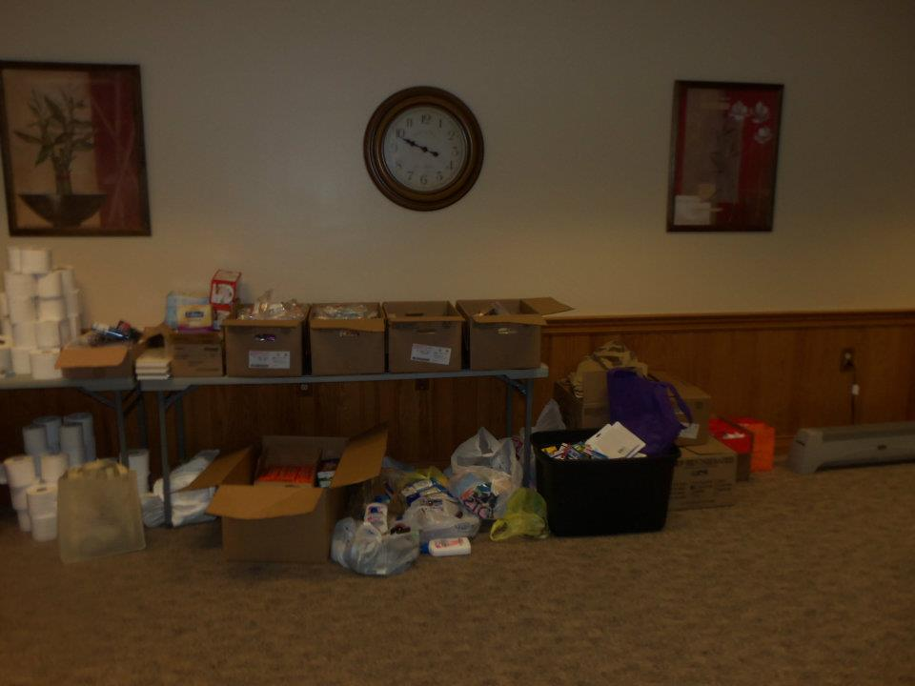
Donations
Hair cuts
Water
Tarps
Socks
Hats
Gloves
Scarves
Discounted Food

Slide 6
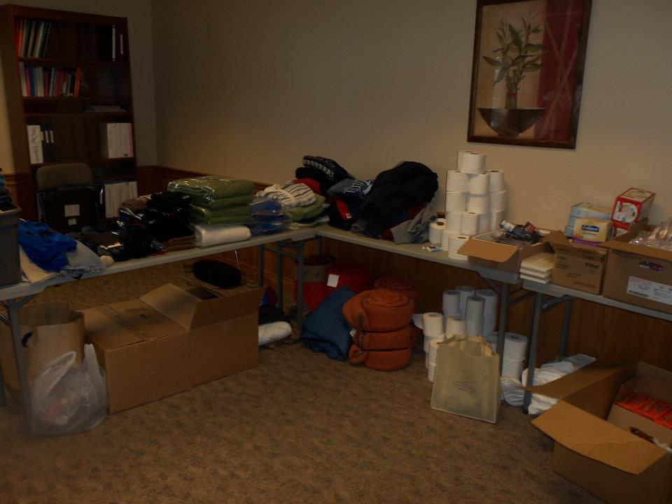
Donors
Domino’s Pizza
Tim Hortons
Prime Meats and Deli
Country Hearth
Kenwood
Chrisman H2O
Donatos
Razor’s Edge
3 Moms Catering
Campbell Wahl Afterhours
Fayette County Transportation
Hartley Oil
Sue Raypole
Southside Church
TSC
Allen Griffiths
My Sister’s House
Elk’s Lodge
Lynne Barbiero
Rose Avenue Community Center
St. Catherines
Walmart
Merchants National Bank
Weade Realtors
Doug Marine Motors
Gene and Charles Carson (call for church name)
Steve Wilson
Advantage Bank
Donation Committee Chair

Slide 7
PIT COUNT @ A GLANCE
 | Sheltered | Unsheltered | At-Risk
Individuals | 71 | 18 | 171
Households | 21 | 17 | 56
Adults | 28 | 18 | 77
Children | 43 | 0 | 94

Slide 8
Homeless Percentages

Slide 9
Percentage by Family Type

Slide 10
Adults vs. Children
Notes:
In the sheltered population this is a 60-40 distribution

Slide 11
Year by Year Comparison

Slide 12
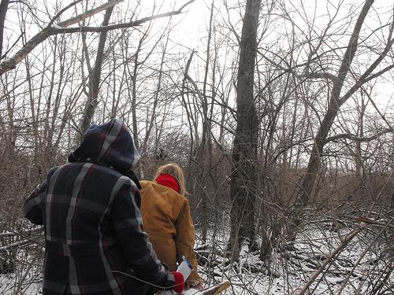
Subpopulations
Sheltered
SMI = 1.9%
Substance Abuse =1.9%
Domestic Violence=5.8%
Veterans = 0%
Unsheltered
SMI = 44%
Substance Abuse = 28%
Domestic Violence = 5%

Slide 13
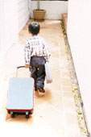
At-Risk Population
At-Risk
50 Households
45 Families
Couch Surfing
6 Households
11 Singles/Couples
(Couch Surfing & At-Risk)

Slide 14
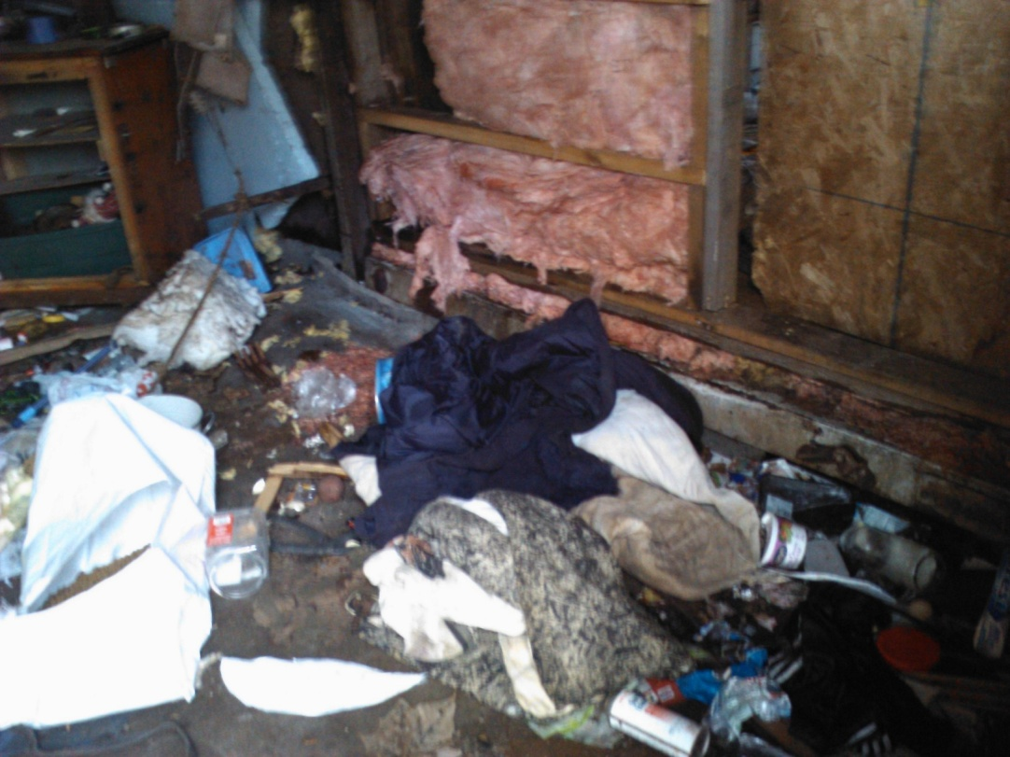
Homeless Project Connect
9 AM – 8 PM
20 adults reporting
7 HUD homeless

Slide 15
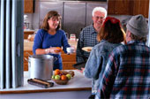
Questions

