Slide 1
Point in Time 2013
Everyone Counts!

Slide 2
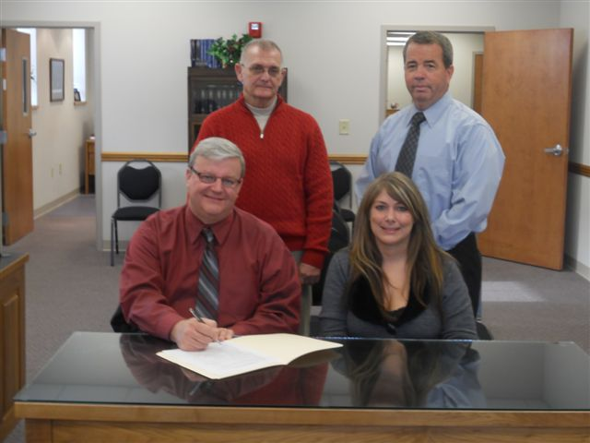
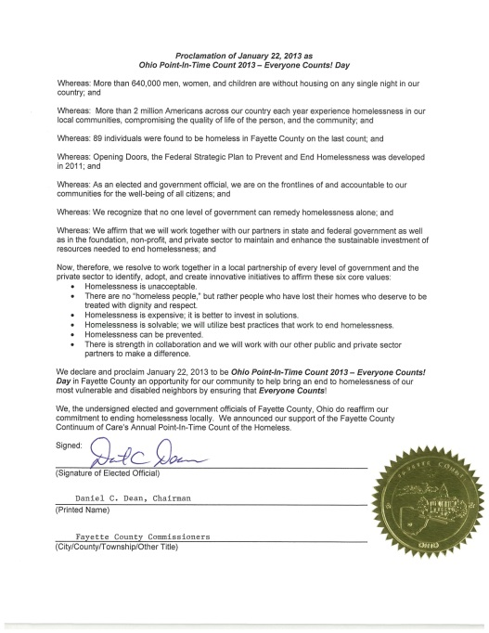
Before the Count
Community Outreach
County Trainings
3 Newspaper Articles
Contacting Agencies/Churches
Local Governmental Support – County Resolution

Slide 3
Methods
Service-Based
Street
Sheltered
Project Connect
School District
Notes:
Service-Based – 3
Street – 11
Sheltered – 51 3(MSH)
SD- 41 HH – 146 individuals
Project Connect – 7 homeless, 9 at risk 4 couch =20 adults; 7 children (27)

Slide 4
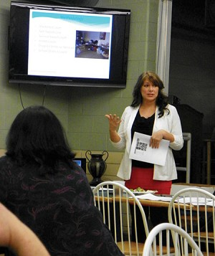
Volunteers
23 Individuals Volunteered for the Project Homeless Connect & Street Count

Slide 5
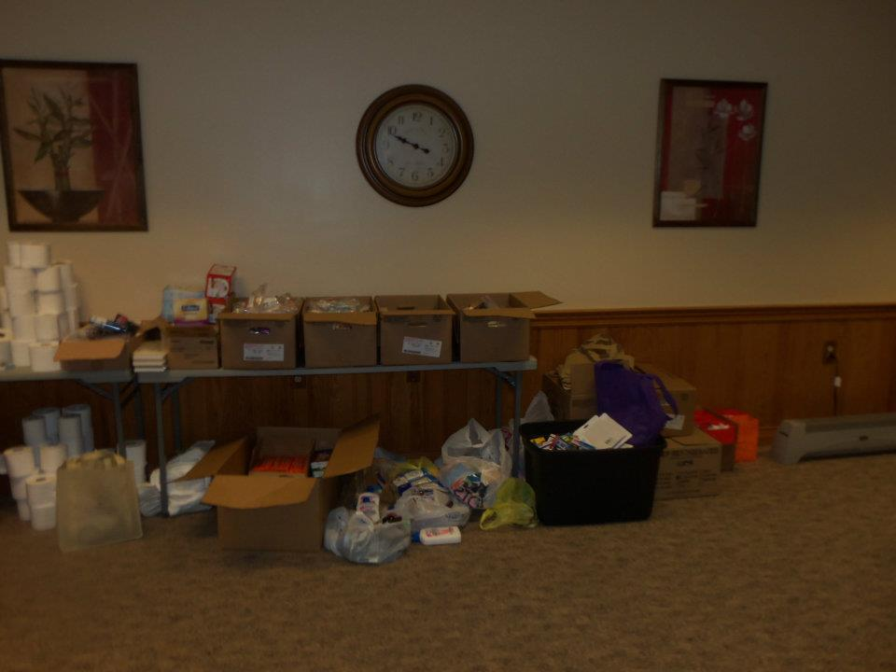
Donations
.
Hair cuts
Water
Tarps
Socks
Hats
Gloves
Scarves
Discounted Food
Medical Assistance
Etc

Slide 6
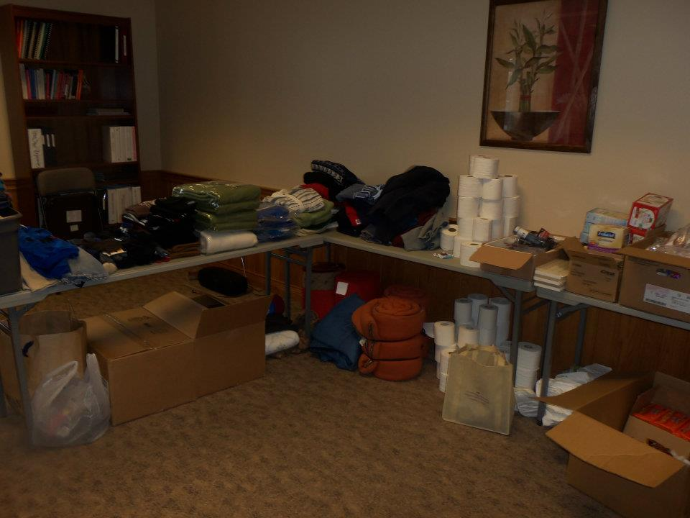
Donors
Donatos
Country Hearth
St Catherine's
Campbell Wahl
Razor’s Edge
Hartley Oil
TSC
Merchants National Bank
Weade Realtors
Chrisman H20
Dominos
My Sister’s House
Allen Griffiths Vision
Walmart
Tim Horton's
3 Mom’s Catering
Southside Church
15 private individuals
Donation Committee Chair

Slide 7
PIT COUNT @ A GLANCE
 | Sheltered | Unsheltered | At-Risk
Individuals | 53 | 6 | 80
Households | 15 | 5 | 20
Adults | 18 | 6 | 49
Children | 35 | 0 | 31

Slide 8
Homeless Program Percentages
Over 78% of Fayette County’s homeless live in transitional housing

Slide 9
Percentage by Family Type
Single Parents comprise the majority of homeless families in Fayette County

Slide 10
Adults vs. Children
2/3 of Fayette County Homeless are Children
Notes:
In the sheltered population this is a 60-40 distribution

Slide 11
Year by Year Comparison

Slide 12
Subpopulations
Sheltered
4 DV = 2%
Unsheltered
SMI = 17%
Chronic Homeless = 17%

Slide 13
At-Risk of Homelessness
80 individuals reported as at-risk of homelessness
49 adults; 31 children
School District Count only completed by one school district
23 – Drop-in Center
57- Miami Trace School Count

Slide 14
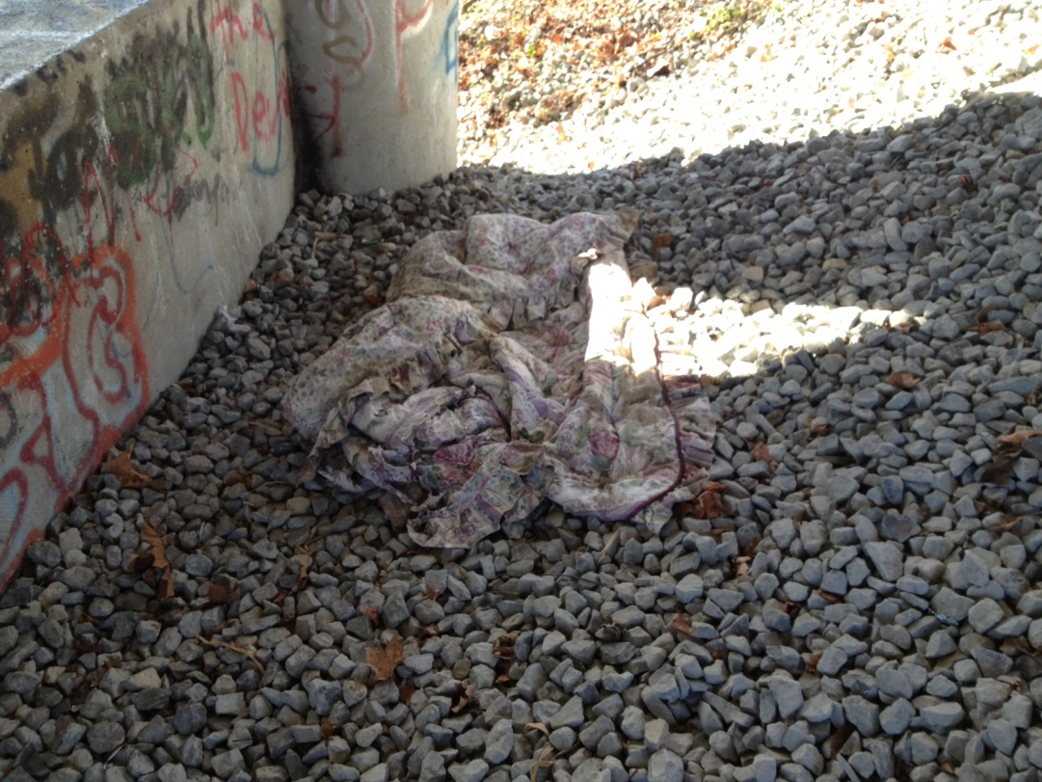
Homeless Project Connect
9 AM – 3 PM
20 adults reporting
7 HUD homeless

Slide 15
Questions

