Slide 1
Drug Abuse Prevention Survey
Friday, November 04, 2016

Slide 2
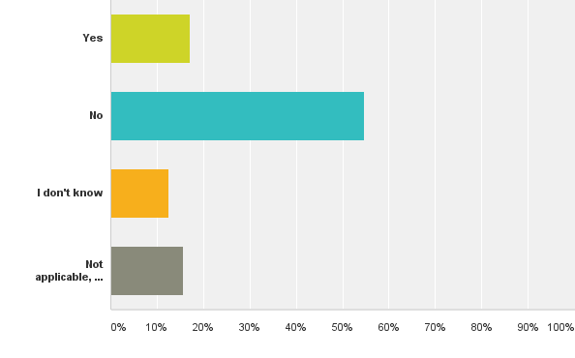
Q3: Does your agency/organization have specialized services for substance abuse prevention activities?
Answered: 64 Skipped: 3

Slide 3
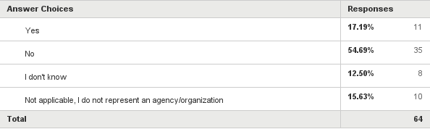
Q3: Does your agency/organization have specialized services for substance abuse prevention activities?
Answered: 64 Skipped: 3

Slide 4
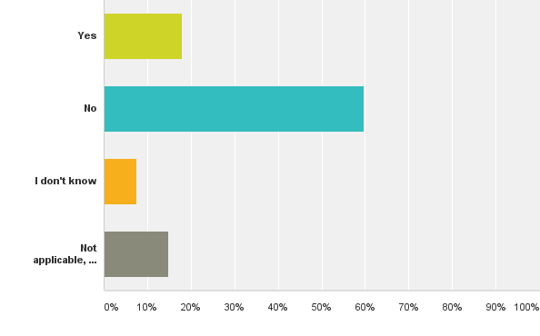
Q4: Does your agency/organization have substance abuse treatment services?
Answered: 67 Skipped: 0

Slide 5

Q4: Does your agency/organization have substance abuse treatment services?
Answered: 67 Skipped: 0

Slide 6
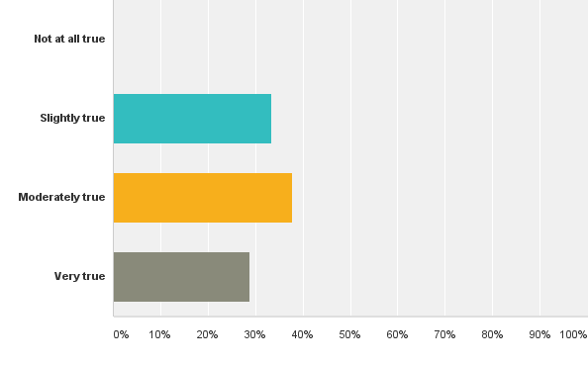
Q5: I am aware of programs in my community which address alcohol and other drug abuse prevention
Answered: 66 Skipped: 1

Slide 7
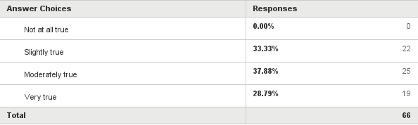
Q5: I am aware of programs in my community which address alcohol and other drug abuse prevention
Answered: 66 Skipped: 1

Slide 8
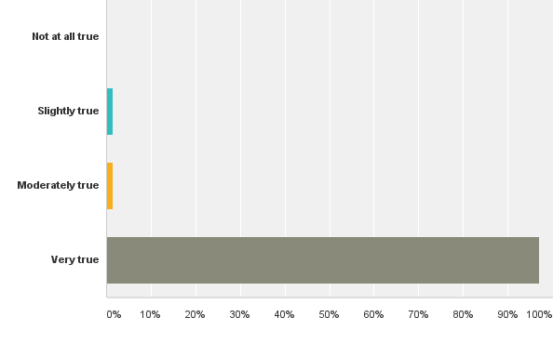
Q6: I believe preventing alcohol and other drug abuse amongst youth is important
Answered: 67 Skipped: 0

Slide 9
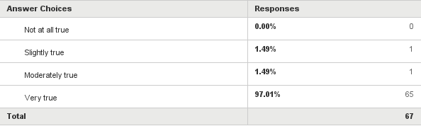
Q6: I believe preventing alcohol and other drug abuse amongst youth is important
Answered: 67 Skipped: 0

Slide 10
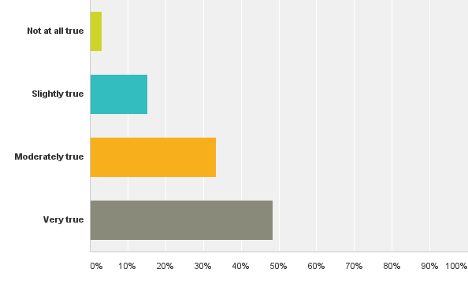
Q7: I am interested in becoming actively involved in improving alcohol and other drug abuse prevention programs in my community
Answered: 66 Skipped: 1

Slide 11

Q7: I am interested in becoming actively involved in improving alcohol and other drug abuse prevention programs in my community
Answered: 66 Skipped: 1

Slide 12
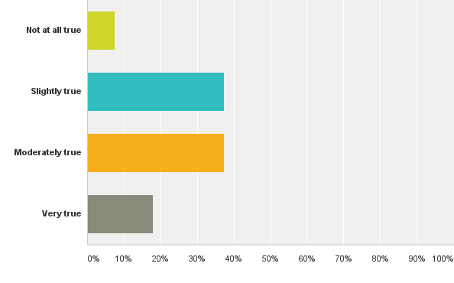
Q8: I know which alcohol and other drug abuse prevention programs serve my community
Answered: 67 Skipped: 0

Slide 13

Q8: I know which alcohol and other drug abuse prevention programs serve my community
Answered: 67 Skipped: 0

Slide 14
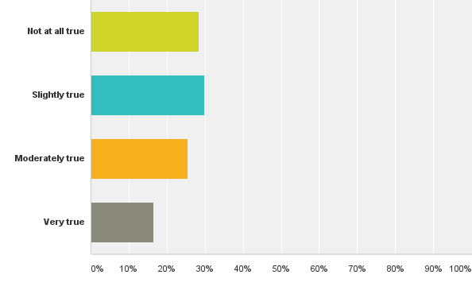
Q9: I can distinguish the type of services offered by the different alcohol and other drug abuse programs in my community
Answered: 67 Skipped: 0

Slide 15
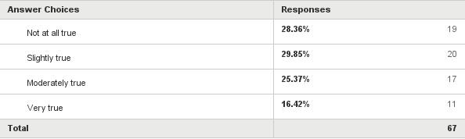
Q9: I can distinguish the type of services offered by the different alcohol and other drug abuse programs in my community
Answered: 67 Skipped: 0

Slide 16
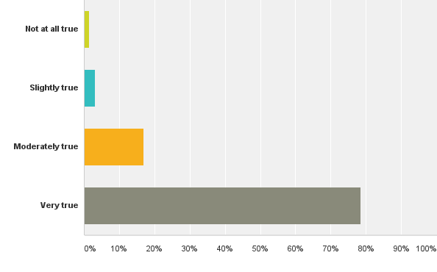
Q10: I am concerned about whether my community has sufficient alcohol and other drug abuse prevention programs
Answered: 65 Skipped: 2

Slide 17

Q10: I am concerned about whether my community has sufficient alcohol and other drug abuse prevention programs
Answered: 65 Skipped: 2

Slide 18
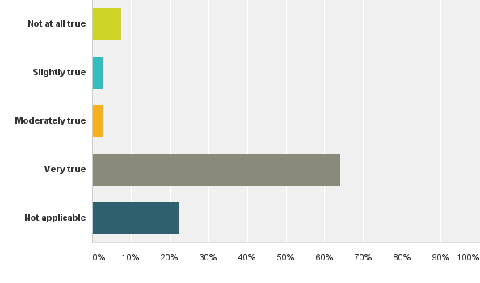
Q11: My agency/organization has a written policy concerning the use of alcohol or other drugs by employees
Answered: 67 Skipped: 0

Slide 19
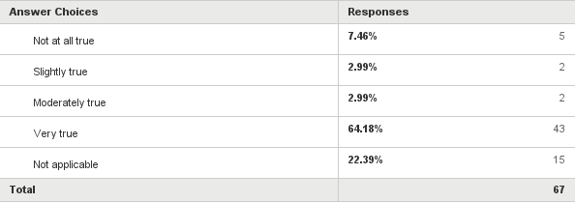
Q11: My agency/organization has a written policy concerning the use of alcohol or other drugs by employees
Answered: 67 Skipped: 0

Slide 20
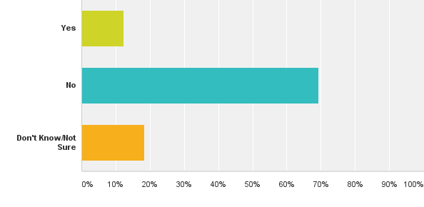
Q12: Is there ever a time or circumstance in which members of your community think that substance abuse should be tolerated?
Answered: 65 Skipped: 2

Slide 21
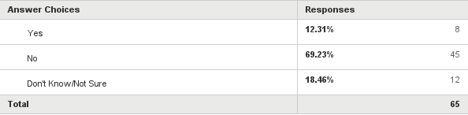
Q12: Is there ever a time or circumstance in which members of your community think that substance abuse should be tolerated?
Answered: 65 Skipped: 2

Slide 22
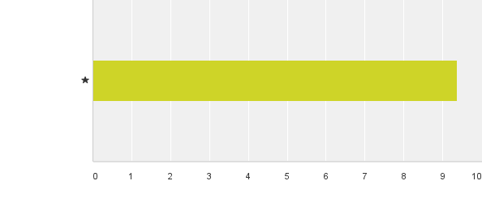
Q13: On a scale from 1 to 10, how much of a concern is substance abuse in your community, with 1 being "no concern" and 10 being "very large concern"?
Answered: 67 Skipped: 0

Slide 23

Q13: On a scale from 1 to 10, how much of a concern is substance abuse in your community, with 1 being "no concern" and 10 being "very large concern"?
Answered: 67 Skipped: 0

Slide 24
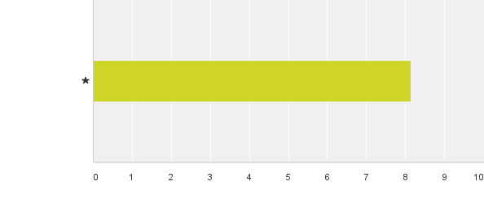
Q14: On a scale from 1 to 10, what is your community's attitude about substance abuse prevention, with 1 being "not important" and 10 being "very important"?
Answered: 66 Skipped: 1

Slide 25

Q14: On a scale from 1 to 10, what is your community's attitude about substance abuse prevention, with 1 being "not important" and 10 being "very important"?
Answered: 66 Skipped: 1

Slide 26
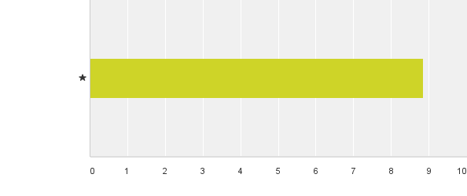
Q15: On a scale from 1 to 10, how important is it to your community to prevent substance abuse among youth, with 1 being "not important" and 10 being "very important"?
Answered: 66 Skipped: 1

Slide 27

Q15: On a scale from 1 to 10, how important is it to your community to prevent substance abuse among youth, with 1 being "not important" and 10 being "very important"?
Answered: 66 Skipped: 1

Slide 28
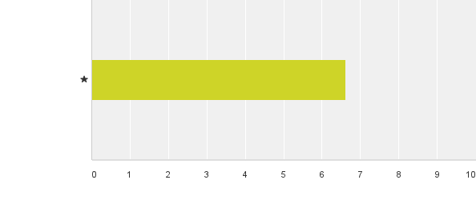
Q16: On a scale from 1 to 10, how supportive are the local businesses in your community of substance abuse prevention efforts (such as volunteering time, making financial donations, providing space, workplace policies, etc), with 1 being "not supportive" and 10 being "very supportive"?
Answered: 65 Skipped: 2

Slide 29

Q16: On a scale from 1 to 10, how supportive are the local businesses in your community of substance abuse prevention efforts (such as volunteering time, making financial donations, providing space, workplace policies, etc), with 1 being "not supportive" and 10 being "very supportive"?
Answered: 65 Skipped: 2

Slide 30
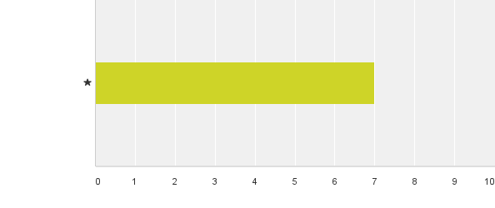
Q17: On a scale from 1 to 10, how supportive are the citizens in your community of substance abuse prevention efforts, with 1 being "not supportive" and 10 being "very supportive"?
Answered: 65 Skipped: 2

Slide 31

Q17: On a scale from 1 to 10, how supportive are the citizens in your community of substance abuse prevention efforts, with 1 being "not supportive" and 10 being "very supportive"?
Answered: 65 Skipped: 2

Slide 32
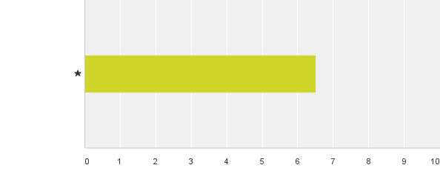
Q18: On a scale from 1 to 10, how much collaboration occurs among public and private agencies involved in substance abuse prevention, with 1 being "no collaboration" and 10 being "extensive collaboration"?
Answered: 64 Skipped: 3

Slide 33

Q18: On a scale from 1 to 10, how much collaboration occurs among public and private agencies involved in substance abuse prevention, with 1 being "no collaboration" and 10 being "extensive collaboration"?
Answered: 64 Skipped: 3

Slide 34
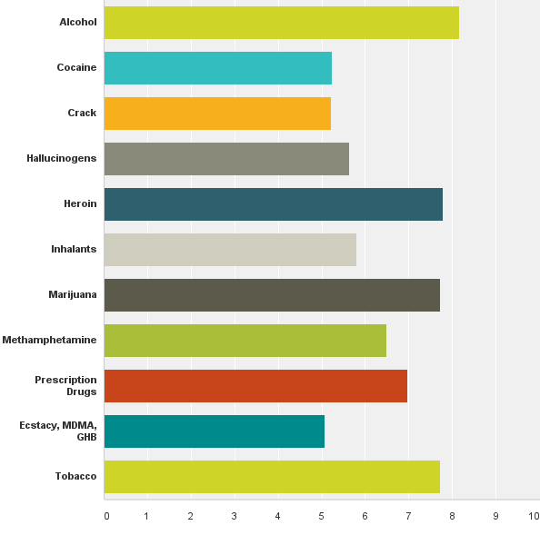
Q19: On a scale from 1 to 10, rate the following substances on the number of problems they cause individuals 18 years of age and younger in Fayette County, with 1 being "causing no problems" and 10 being "causing many problems".
Answered: 64 Skipped: 3

Slide 35
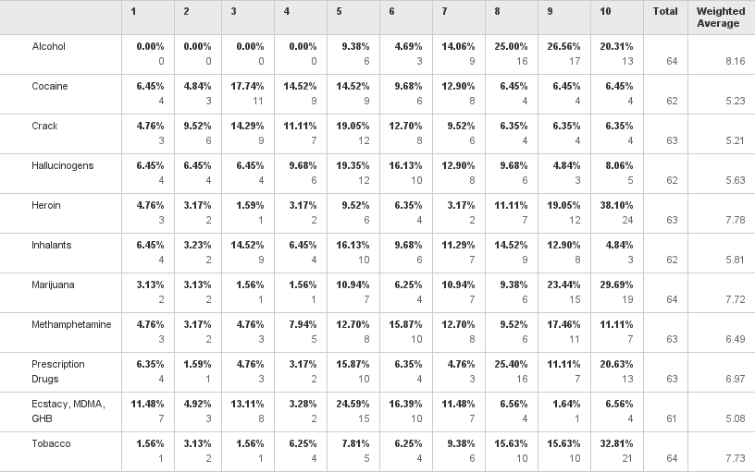
Q19: On a scale from 1 to 10, rate the following substances on the number of problems they cause individuals 18 years of age and younger in Fayette County, with 1 being "causing no problems" and 10 being "causing many problems".
Answered: 64 Skipped: 3

Slide 36
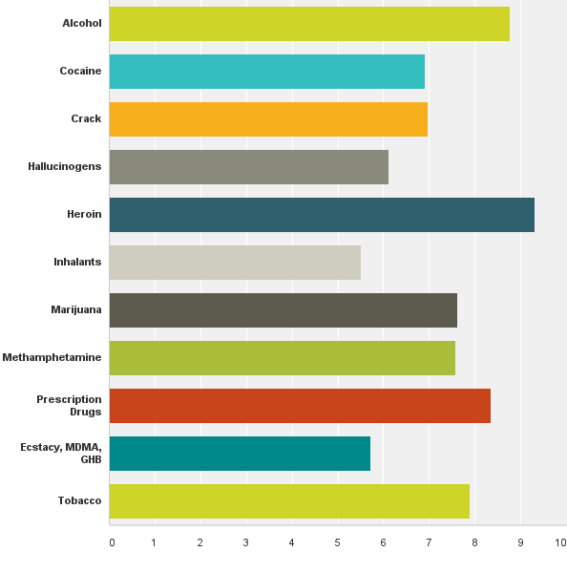
Q20: On a scale from 1 to 10, rate the following substances on the number of problems they cause individuals 19 years of age and older in Fayette County, with 1 being "causing no problems" and 10 being "causing many problems".
Answered: 66 Skipped: 1

Slide 37
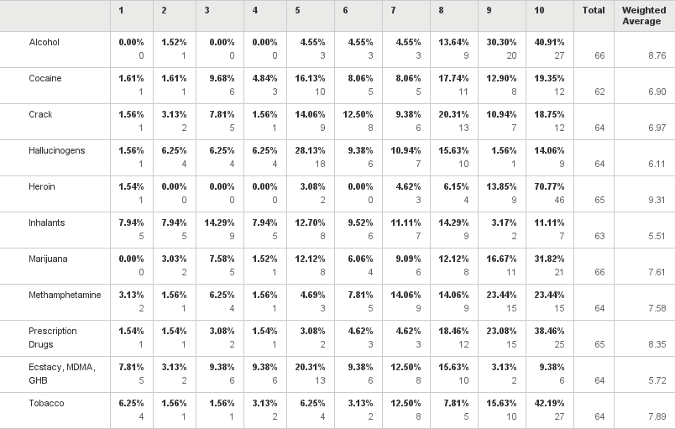
Q20: On a scale from 1 to 10, rate the following substances on the number of problems they cause individuals 19 years of age and older in Fayette County, with 1 being "causing no problems" and 10 being "causing many problems".
Answered: 66 Skipped: 1

Slide 38
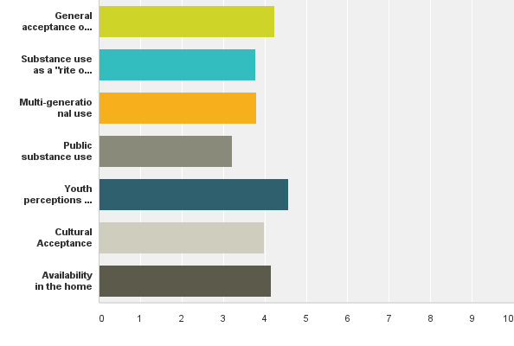
Q22: Interpersonal factors that contribute to substance abuse are listed below. Please rank these factors from 1-7, with 1 being the most influential factor and 7 being the least.
Answered: 63 Skipped: 4

Slide 39
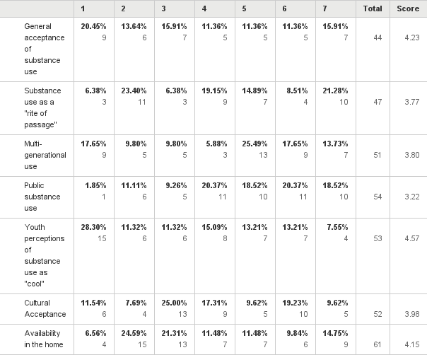
Q22: Interpersonal factors that contribute to substance abuse are listed below. Please rank these factors from 1-7, with 1 being the most influential factor and 7 being the least.
Answered: 63 Skipped: 4

