Slide 1
Juvenile probation survey
Survey of kids on juvenile probation in Fayette county, ohio

Slide 2
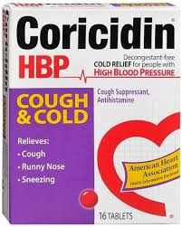
When you committed the offense you were arrested for were you under the influence of drugs and/or alcohol?
32% WERE UNDER THE INFLUENCE
  6 – MARIJUANA SMOKERS
  2 – TOBACCO USE
  1 – “TRIPLE C” – HALLUCINOGIN EFFECT

Slide 3
Have you failed a drug screen while on probation?
55% failed a drug screen
  12 – marijuana
  3 – cocaine
  2 – tobacco use
  1 – alcohol
  1 – reported multiple drugs of abuse, including: heroine, prescription drugs, and ecstasy

Slide 4
Perception of harm

Slide 5
Contributing factors
Peer Use - 37
Cultural Acceptance - 30
Accessibility - 30
Family Use - 11

