Slide 1
Prescription Drugs/Opiates Teen Norms Survey
Friday, January 19, 2018

Slide 2
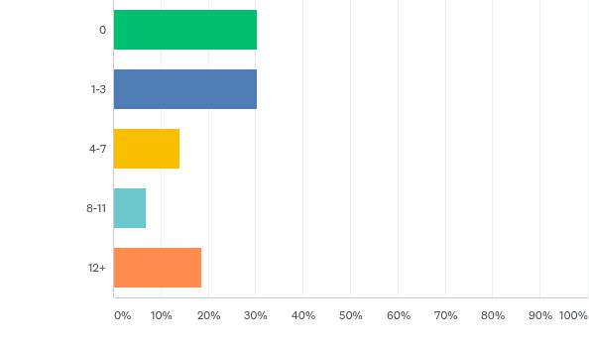
Q1: How many times during the school year have you seen or heard educational information about prescription drug misuse?
Answered: 43 Skipped: 1

Slide 3
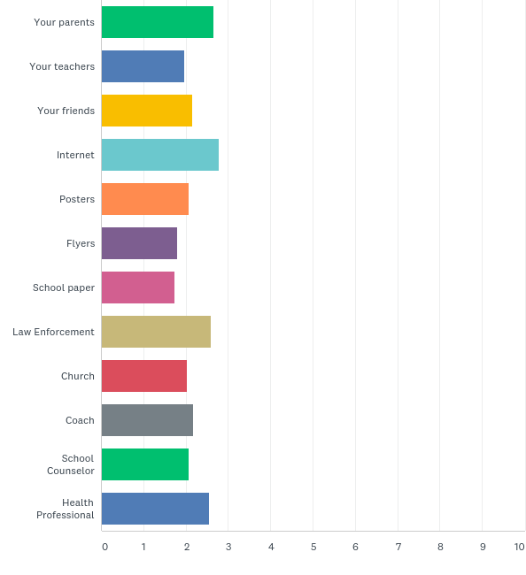
Q2: During the school year, how frequently have you seen or heard information about prescription drugs from the following sources:
Answered: 44 Skipped: 0

Slide 4
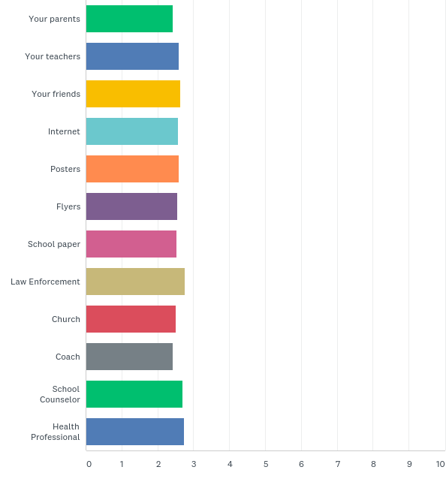
Q3: Please rate how believable each of the following sources of information about prescription drugs are to you:
Answered: 43 Skipped: 1

Slide 5
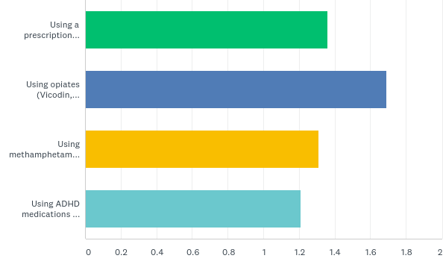
Q4: Please indicate how much you think the typical student approves or disapproves of each of the following:
Answered: 42 Skipped: 2

Slide 6
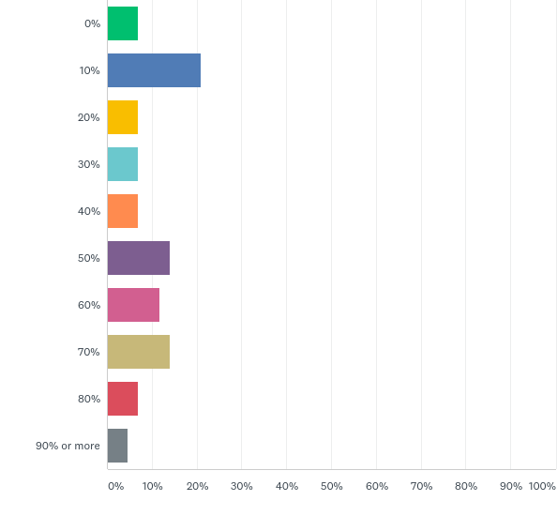
Q5: What percentage of students do you believe have used a prescription medication to get high in the past 30 days?
Answered: 43 Skipped: 1

Slide 7
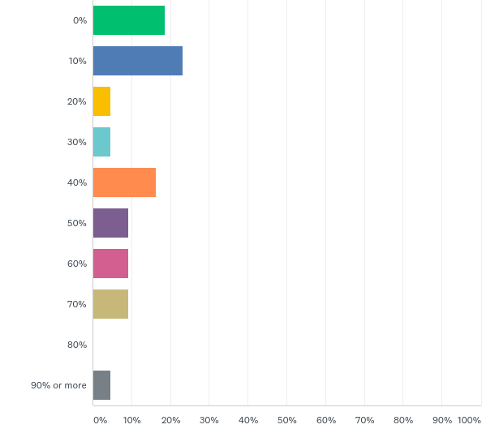
Q6: What percentage of students do you believe have used an opiate (OxyContin, Vicodin, Percocet, etc) in the past 30 days?
Answered: 43 Skipped: 1

Slide 8
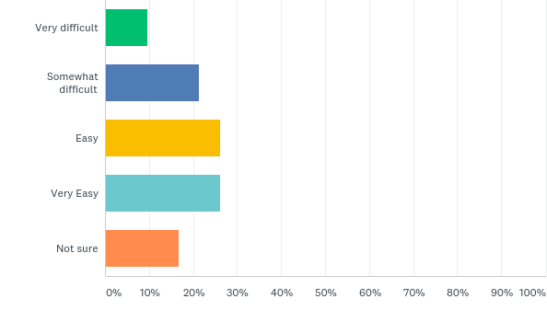
Q7: In your opinion, how easy would it be for someone to obtain an opiate (OxyContin, Vicodin, Percocet) or other prescription medication from a doctor in your community to get high?
Answered: 42 Skipped: 2

Slide 9
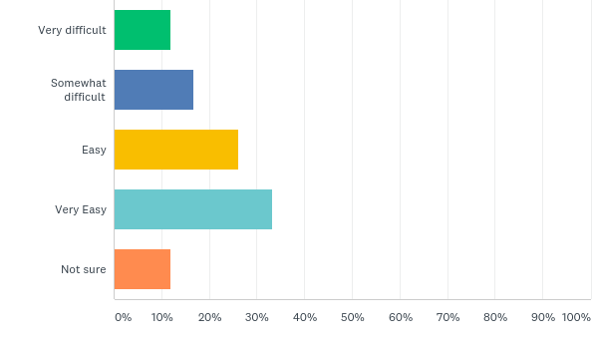
Q8: In your opinion, how easy would it be for someone to obtain an opiate (OxyContin, Vicodin, Percocet) or other prescription medication from a friend or family member in your community to get high?
Answered: 42 Skipped: 2

Slide 10
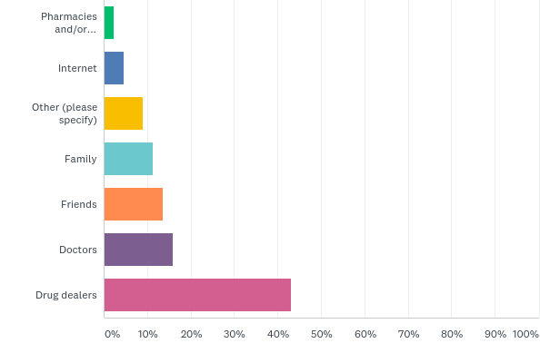
Q9: In your opinion how do people who abuse opiates and other prescription medication obtain it?
Answered: 44 Skipped: 0

